Slide 1
Introduction to FHIR
Eric Haas
January 11, 2015

Slide 2
This presentation
Can be downloaded here:
http://gforge.hl7.org/svn/fhir/trunk/presentations/2016-1 Tutorials/Introduction to FHIR.pptx
Use “anonymous” and email address to logon
Is licensed for use under the Creative Commons, specifically:
Creative Commons Attribution 3.0 Unported License
(Do with it as you wish, so long as you give credit)

Slide 3
Acknowledgements
Grahame Grieve
Lloyd McKenzie
Ewout Kramer
David Hay
Josh Mandel

Slide 4
Agenda
Introductions
Background to FHIR
Paradigms & Architectures
Resources
API Exchange
Profiling
Implementation
Wrap up

Slide 5
Who am I?
Name: Eric Haas
Company: Health eData Inc
Background:
Involved in FHIR since 2012
Veterinarian
FHIR editor for Orders and Observations
Author of several FHIR resources and FHIR profile
Authored V2 and CDA implementation guides as well

Slide 6
Who are you?
What’s your background with HL7?
v2? v3? CDA? Brand new?
What’s your role?
Developer? Manager? Clinician? Other?
What’s the single most important thing for you to get out of today’s course?
Please be brief!

Slide 7
Tutorial Objectives
You should:
Know where FHIR fits in the broader healthcare landscape, including other HL7 specifications
Be able to explain what FHIR is to others in your organization, and what impact it might have
Be equipped to help your organization determine if, when, where and how you might use FHIR
*Know how to approach the FHIR specification to find out what more you need to know
Be prepared for the more detailed tutorials
Be able to engage with the community
Notes:
I will be trying to use the FHIR specification throughout this tutorial. Try to tie the topic into the spec and where the information can be found. So slides such as the following will be interspersed into the discussion as queus to jump to spec…..
Come back to this at end to see if objectives have been met.

Slide 8
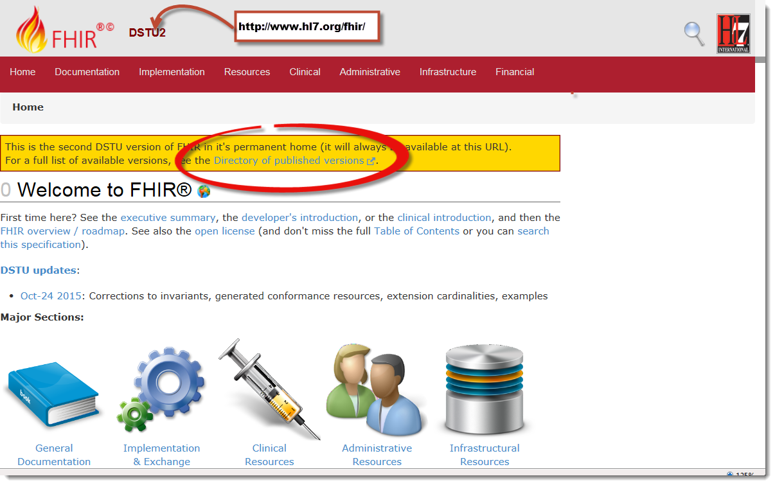
The FHIR Spec – DSTU2
Notes:
Published as HTML
Objective of spec is developer can skim and decide in < day
Published using validation process that performs consistency checks – like a software build
Lots of stuff in there like a many roomed mansion so can get lost….
Note on versions prior and future e.g. “continuous integration build”

Slide 9
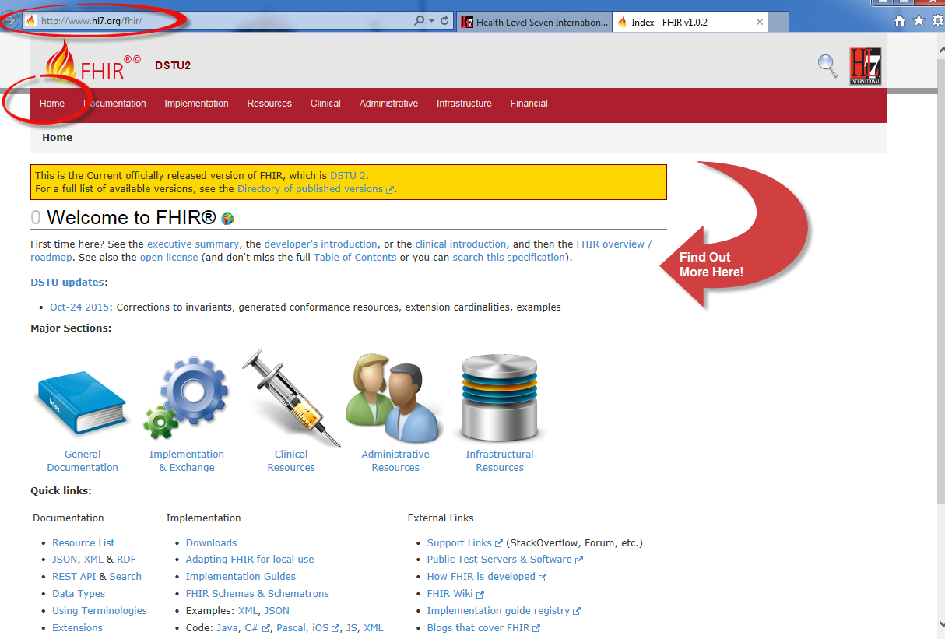
What is FHIR?
Notes:
Intro to specification, web site, home page and more introductory information.

Slide 10

Answer: An instigator of bad puns
FHIR is the hottest thing since . . .
This spec is spreading like wild. . .
This company is really on FHIR
Feel free to come up with your own
(but please, not here ☺)

Slide 11




The Acronym
– Fast (to design & to implement)
Relative – No technology can make integration as fast as we’d like
– Health
That’s why we’re here
– Interoperable
Ditto
– Resources
Building blocks – more on these to follow
Notes:
9:25

Slide 12
Genesis of FHIR
Has been a need to share healthcare information electronically for a long time
Increasing pressure to broaden scope of sharing
Across organizations, disciplines, even borders
Mobile, Device & Cloud-based applications
Faster – integration in days or weeks, not months or years
Notes:
Pre-History:
For example v2 is over 25 years old
My personal experience is in Public Health where there is a need to collect information from many organizations.
Currently takes too long and costs too much…

Slide 13
Genesis of FHIR
Q: So what did HL7 have to offer in this space?
A:
V2 old, and limited by it’s own rules (though hugely successful)
V3 too slow and too hard
CDA has success, but both limited and too hard
Different contexts of interoperability → different representations that aren’t compatible
Nothing suitable for light-weight integration, or for Health 2.0
Notes:
CDA based on V3 but limited to document exchange. ( for example does not support workflow ) Many templates are “semantically challenged”.
“Different contexts of interoperability” means can’t switch from messaging to documents easily. Is this a real world problem?
Light-weight integration -for example a mobile app or wearable device.
Health 2.0 From Wikipedia “Health 2.0 refers to the use of a diverse set of technologies including telemedicine, electronic medical records, mHealth, Connected Health, and the use of the internet by patients themselves such as through messageboards, blogs, online communities, patient to physician communication systems and other more advanced systems. A key concept is that patients themselves should have greater insight and control into information generated about them. Additionally Health 2.0 relies on the use of modern cloud and mobile-based technologies.”
Basically technology and the Web had evolved and HL7’s existing standards had not. In the end to succeed need a standard that will help make money and save money.

Slide 14
Complexity Model
Snomed
HL7 V3
openEHR
WS
CDA
Difficulty (log)
XML
How?
HL7 v2
HTTP / HTML
???
Text
Semantic Depth
Notes:
Stole this slide from Lloyd. Because I like it.
Sematic Depth - Knowledge captured in the model.
V2 old, and limited by it’s own rules (though hugely successful)
- V2 version 2 messaging. Pipes and Hats (EDIfact) format – 25 yrs old. Very implementation specific so no two implementations are the same which leads to the need for integration engines to coax interoperability. Doesn’t scale well across organization boundaries
V3 too slow and too hard
- 3-7+ years for a domain to become normative. V3 messaging not widely implemented. Robust modeling but complex and opaque and thus hard to implement. ( for example the content is cluttered with semantic structures )
CDA has success, but both limited and too hard
+ Different contexts of interoperability → different representations that aren’t compatible
Nothing suitable for light-weight integration or for Health 2.0 (WIKIpedia: “While the "2.0" moniker was originally associated with concepts like social networking, collaboration, openness, and participation,^{[5]} in recent years the use of Health 2.0 has migrated to mean the role of Saas & Cloud-based technologies and their associated applications on multiple devices. Health 2.0 describes the integration of these into much of general clinical and administrative workflow in health care.”
Question is how to get both semantic depth and ease of implementation?

Slide 15
Three Laws of Interoperability
Interoperability: It’s all about the people
You can hide the complexity, or make it worse, but you can’t make it go away
Cheap, flexible, and interoperable: pick two
Notes:
From GG
Interop is not about technology is a people issue.
Qualifications – not quite true

Slide 16

Genesis of FHIR
HL7 undertook a “Fresh look”
What would healthcare exchange look like if we started from scratch using modern approaches?
Web search for success markers led to RESTful based APIs
Exemplar: Highrise (https://github.com/37signals/highrise-api)
Drafted a healthcare exchange API based on this approach
Notes:
What is an (restful) API (Application Programming Interface)? Set of services between machines ( like browsing the web only instead of a human at one end you have 2 machines communicating) In other words an API packages and ships information between places. This can mean if you publish your API you can open up you data and functionality to other developers both internally and externally. For example Amazon API can be used by a third party.
REST (REpresentational State Transfer) is an architectural style RESTful is an implementation based upon REST.

Slide 17
Timeline: Where does FHIR fit?
V2
1987
Start V3
1995
V3
CDA
2005
Fresh
Look
2011
FHIR
DSTU 2
2015
FHIR
CDA
V3
V2
1980
1990
2000
2010
2020

Slide 18
Business Case for using FHIR
Predefined Resources & API
Analysis already done, and can be safely extended
All paradigms, All Architectures, All Clients
Thick client, browser, mobile, devices
Implementer friendly
Simple to understand and access with examples
Familiar tooling & familiar technologies – XML/JSON, HTTP, SSL, OAuth
Libraries available – HAPI, Furore, reference implementation
Mobile friendly
Concise, REST API & JSON
Don’t need to understand HealthCare domain to implement
Developers or Analysts
Already in use Internationally
70 Organizations, 20 Countries, all Continents (except Antarctica)
Involvement from Providers, Vendors, Payers, Governments
Large community for support
Results in faster, cheaper deployments that are more re-usable
Notes:
James Agnew - HAPI

Slide 19
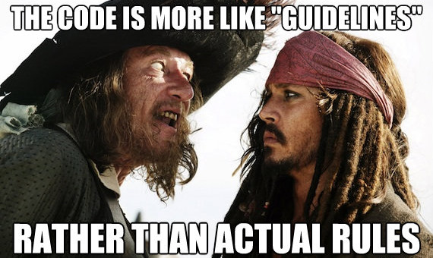
FHIR Manifesto
FYI: Monday, September 19 International Talk Like a Pirate Day 2016
Notes:
We don’t actually have a formal manifesto, but these are more like guidelines we adhere to. Also if we at HL7 manage to get this right and follow these principle is a strong business case for using FHIR.
“Barbossa: First, your return to shore was not part of our negotiations nor our agreement so I must do nothing. And secondly, you must be a pirate for the pirate's code to apply and you're not. And thirdly, the code is more what you'd call "guidelines" than actual rules. Welcome aboard the Black Pearl, Miss Turner . “

Slide 20
FHIR Manifesto
Focus on Implementers
Target support for common scenarios
Leverage cross-industry web technologies
Support human readability as base level of interoperability
Make content freely available
Support multiple paradigms & architectures
Demonstrate best practice governance
Notes:
We don’t actually have a formal manifesto, but these are more like guidelines we adhere to. Also if we at HL7 manage to get this right and follow these principle is a strong business case for using FHIR.
“Barbossa: First, your return to shore was not part of our negotiations nor our agreement so I must do nothing. And secondly, you must be a pirate for the pirate's code to apply and you're not. And thirdly, the code is more what you'd call "guidelines" than actual rules. Welcome aboard the Black Pearl, Miss Turner . “

Slide 21
Implementer Focus
Specification is written for one target audience: implementers
Rationale, modeling approaches, etc. kept elsewhere
Resources are simple and easy to understand and use
Multiple Implementation tools to help get you started from day 1
Publicly available test servers
Starter APIs published with spec
C#, Java, Pascal, ObjectiveC, Javascript
Lots of examples (and they’re valid too)
Connectathons to verify specification approaches
‘Safe’ extensibility baked in
Notes:
Specification is written for one target audience: implementers
Rationale, modeling approaches, etc. kept elsewhere - mappings exist more on this later
Resources are simple and easy to understand and use - more on this later
Multiple Implementation tools to help get you started from day 1
Publicly available test servers
Starter APIs published with spec
C#, Java, Pascal, ObjectiveC, Javascript
Lots of examples (and they’re valid too)
Connectathons to verify specification approaches
‘Safe’ extensibility baked in
Who’s read the v3 spec? – modeler & balloter focused
Spec is driven by people who write code for a living
‘Resource’ is the basic building block of FHIR (more on that later)
Numerous pieces have been changed because of experience with what worked when trying to implement
Even have a test workbench for RESTful servers – URL?
External libraries already available
Whole spec is built like software project

Slide 22
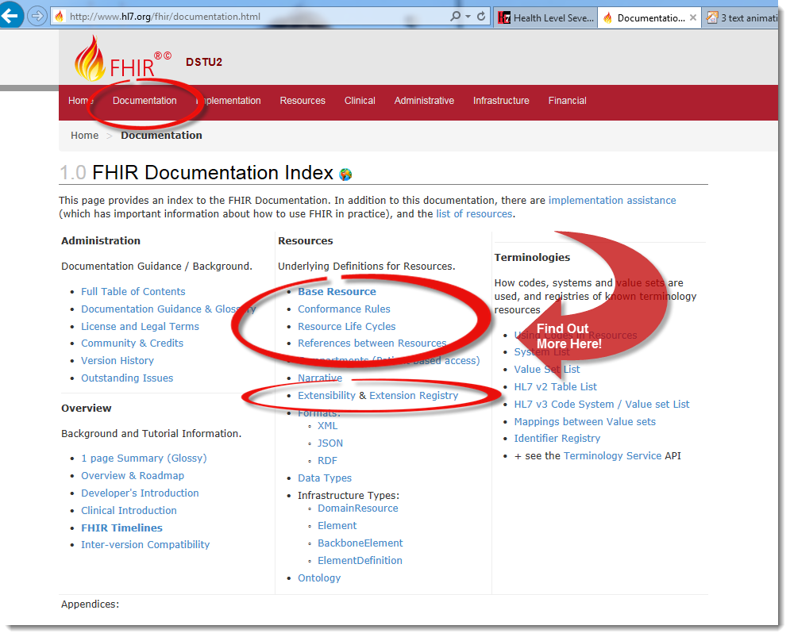
Implementer Focus
Notes:
Specification is written for one target audience: implementers
Rationale, modeling approaches, etc. kept elsewhere
Resources are simple and easy to understand and use → more on resources later
Multiple Implementation tools to help get you started from day 1
Publicly available test servers → go to wiki
Starter APIs published with spec → See downloads
C#, Java, Pascal, ObjectiveC, Javascript
Lots of examples (and they’re valid too) → look at individual resources
Connectathons to verify specification approaches → see wiki
‘Safe’ extensibility baked in → see documentation page
Who’s read the v3 spec? – modeler & balloter focused
Spec is driven by people who write code for a living
‘Resource’ is the basic building block of FHIR (more on that later)
Numerous pieces have been changed because of experience with what worked when trying to implement
Even have a test workbench for RESTful servers – URL?
External libraries already available
Whole spec is built like software project

Slide 23
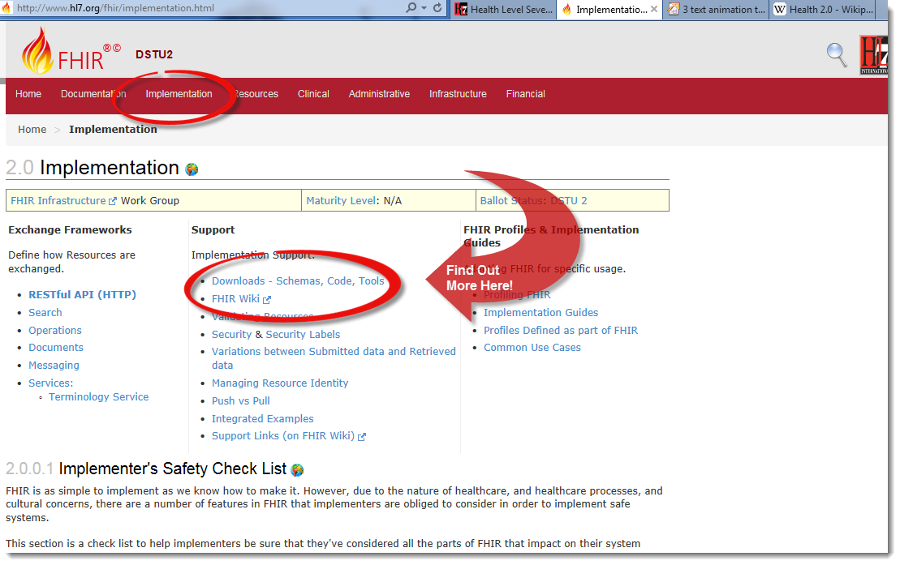
Implementer Focus
Notes:
Specification is written for one target audience: implementers
Rationale, modeling approaches, etc. kept elsewhere
Resources are simple and easy to understand and use → more on resources later
Multiple Implementation tools to help get you started from day 1
Publicly available test servers → go to wiki
Starter APIs published with spec → See downloads
C#, Java, Pascal, ObjectiveC, Javascript
Lots of examples (and they’re valid too) → look at individual resources
Connectathons to verify specification approaches → see wiki
‘Safe’ extensibility baked in → see documentation page
Who’s read the v3 spec? – modeler & balloter focused
Spec is driven by people who write code for a living
‘Resource’ is the basic building block of FHIR (more on that later)
Numerous pieces have been changed because of experience with what worked when trying to implement
Even have a test workbench for RESTful servers – URL?
External libraries already available
Whole spec is built like software project

Slide 24
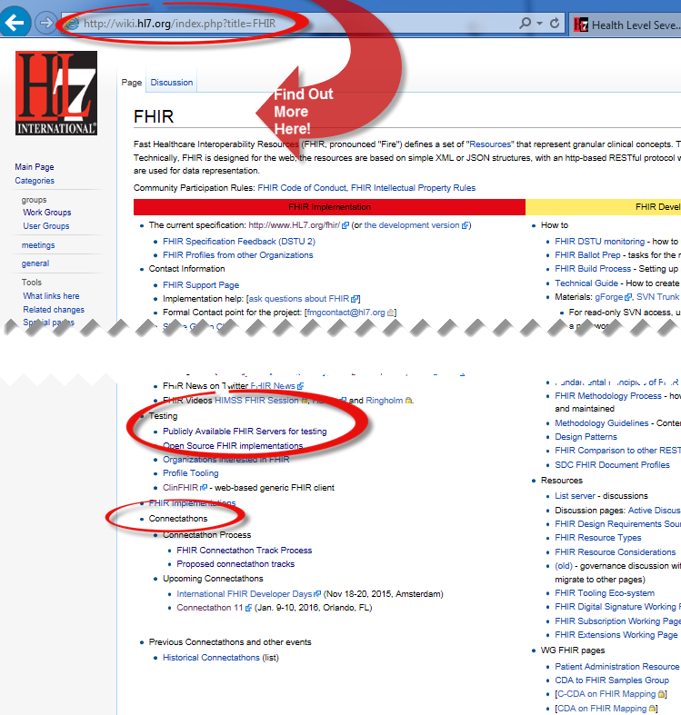
Implementer Focus: Test Servers, Connectathons
Notes:
Multiple Implementation tools to help get you started from day 1
Publicly available test servers
Starter APIs published with spec
C#, Java, Pascal, ObjectiveC, Javascript
Lots of examples (and they’re valid too)
Connectathons to verify specification approaches

Slide 25
Support “Common” Scenarios
Focus on scenarios implementers ask for
Inclusion of content in core specification is based on core content rule
“We only include data elements if we are confident that most normal implementations using that resource will make use of the element” (80%)
Other content in extensions (more on this later)
Easy to say, governance challenge to achieve
Notes:
Design by constraint failed – years to develop, what was produced required yet more design to be implementable and after that might not be interoperable
How to determine the 80%? Look to existing specs – v2, v3, CDA templates, OpenEHR, jurisdictional projects, what implementations we’ve seen
If not sure, err on the side of “not in for now”
Note: not 80% of instances, 80% of implementations
Challenges with “raising the bar”
What happens when there aren’t many/any implementations?

Slide 26
Support “Common” Scenarios: Example – FHIR Address
isNotOrdered, updateMode, flavorId, nullFlavor, controlAct root & extension, validTime low and high, useable period (low, high) (GTS – no room on the slide), use
home, primary home, vacation home, workplace, direct, public, bad, physical, postal, temporary, alphabetic, ideographic, syllabic, search, soundex, phonetic, old
0..* parts, each with:text
value, code, code system, code system name, code system version, language, type:
address line, additional locator, unit identifier, unit designator, delivery address line, delivery installation type, delivery installation area, delivery installation qualifier, delivery mode, delivery mode identifier, street address line, building number, building number numeric, building number suffix, street name, street name base, street type, direction, intersection, care of, census tract, country, county or parish, municipalitycity, delimiter, post box, precinct, state or province, postal codezip, delivery point identifier
Notes:
This is what happens when you apply the 80% . . .

Slide 27
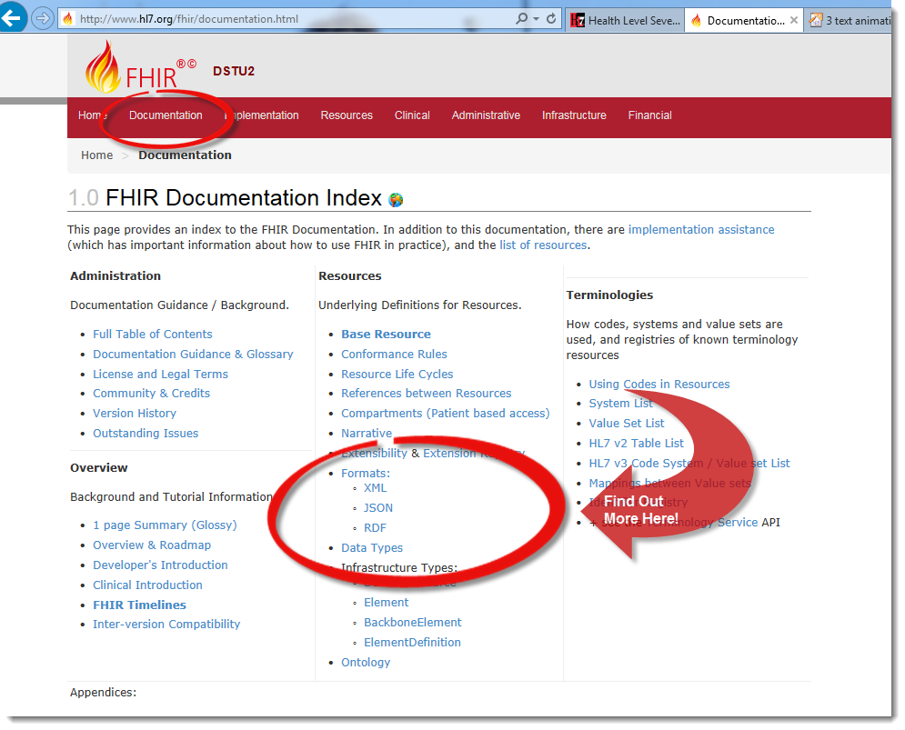
Leverage Cross-Industry Web Technologies
Notes:
‘Safe’ extensibility baked in
HTTP
DataTypes W3C complaint
XML, JSON, RDF

Slide 28
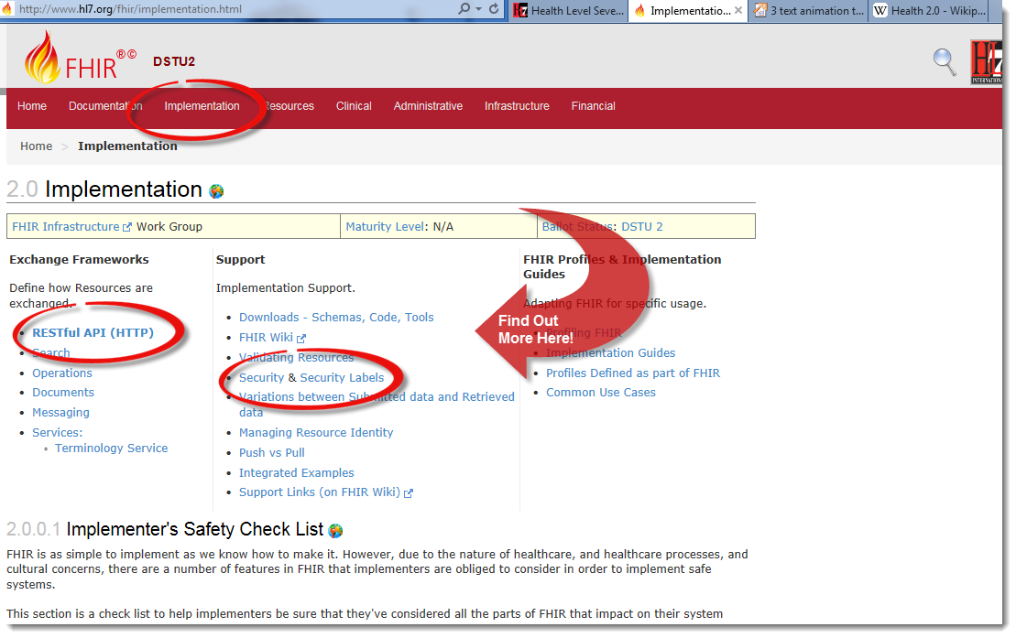
Leverage Cross-Industry Web Technologies
Notes:
We try very hard to *not* invent stuff that exists elsewhere unless it’s really broken or totally unaligned with the FHIR principles
HTTP RESTful implementation based upon REST.
Web calls work the same way they do for Google, Facebook & Twitter
Rely on HTTPS, OAuth, etc. for security functions

Slide 29
Web technologies
HTTP
DataTypes W3C complaint
XML, JSON, RDF
REST supported
Web calls work the same way they do for Google, Facebook & Twitter
Rely on HTTPS, OAuth, etc. for security functions
Notes:
We try very hard to *not* invent stuff that exists elsewhere unless it’s really broken or totally unaligned with the FHIR principles.
Atom was used for collection of resources into a bundles - Replaced in DSTU-2 with FHIR bundle
RESTful implementation based upon REST.

Slide 30

Human Readable
In FHIR, every resource should have a human-readable expression
Can be direct rendering or human entered
CDA got this part right.
Notes:
Even when you think your target will understand all the encoded data, reality is data often gets shared beyond the originally intended context
Allow for exceptions for things like automated device readings, etc.

Slide 31
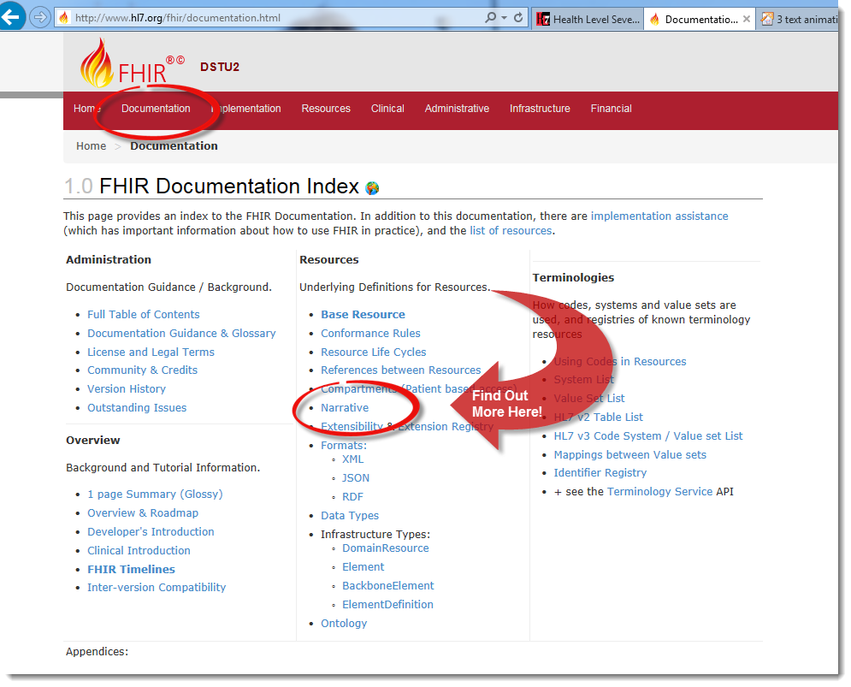
Human Readable
Мммм ... Интересно, что на обед ?
Notes:
In FHIR, every resource should have a human-readable expression
Can be direct rendering or human entered
Even when you think your target will understand all the encoded data, reality is data often gets shared beyond the originally intended context
Allow for exceptions for things like automated device readings, etc.
(CDA got this part right.) What is that person doing?.... Specification is Translated in several Russian and Japanese too. Obviously the narrative supports mulitple languages too.

Slide 32
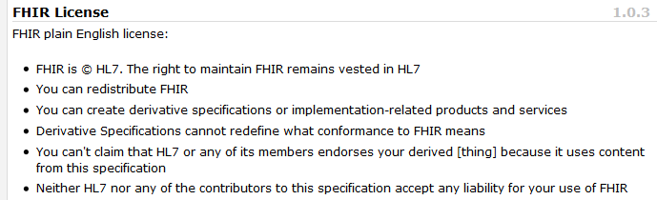
Freely available
Unencumbered – free for use, no membership required
http://hl7.org/fhir
Notes:
Was a bigger deal before HL7 decided to open up all IP
full legal text towards bottom of FHIR home page

Slide 33
Governance
Oversight
TSC
Governance
FGB
Methodology
MnM
Management
FMG
Content
Work Groups
Notes:
FHIR Governance Board
Maintains FHIR principles
Identifies risks, precepts
Handles coordination w/ external groups
FHIR Management Group
Coordinates Work Groups
Manages ballot process
Education delivery
Day-to-day activities
Modeling & Methodology
Defines criteria for artifacts
Determines processes
Documents best practices
Work Groups
Do the actual development work
What haven’t we talked about yet?

Slide 34
Paradigms and Architectures
Notes:
9:45

Slide 35
Support for Multiple Paradigms
FHIR supports these interoperability paradigms
Content stays the same
REST
Documents
Messages
Services
Notes:
FHIR supports these interoperability paradigms
Content stays the same
Regardless of approach, content stays the same
Can leverage same models, same profiles everywhere
Does everybody know what these 4 things are or should I explain them.

Slide 36
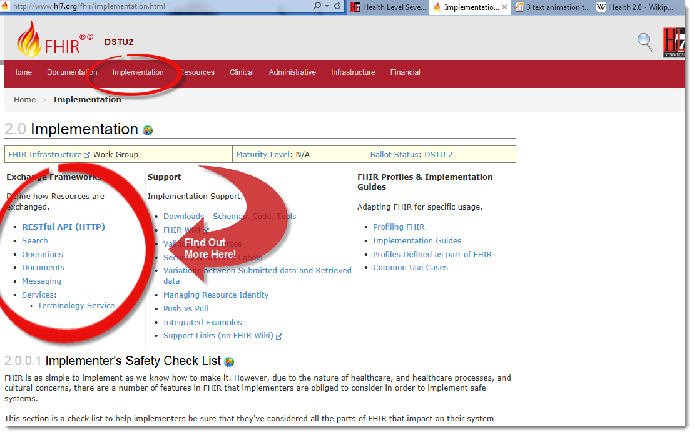
Support for Multiple Paradigms
Notes:
FHIR supports these interoperability paradigms - Content stays the same
RESTful API ( REST )
Search big part of REST
Operations (RPC) paradigm : wWkipedia: “In computer science, a remote procedure call (RPC) is client/server system in which a computer program causes a subroutine or procedure to execute in another address space (commonly on another computer on a shared network) without the programmer explicitly coding the details for this remote interaction.[
”
Messaging paradigm (V2)
Documents paradigm (CDA)
Services ( SOA)
Regardless of approach, content stays the same
Can leverage same models, same profiles everywhere
Does everybody know what these 4 things are or should I explain them. ( See hidden slides)

Slide 37
REST
“Representational state transfer” – an architecture for how to connect systems
“CRUD”
Advantages
Simple stable interfaces
High Performance / Scalability
Visible Process (e.g. can debug)
Portability
Notes:
What is an (restful) API (Application Programming Interface)? Set of services between machines ( like browsing the web only instead of a human at one end you have 2 machines communicating) In other words an API packages and ships information between places. This can mean if you publish your API you can open up you data and functionality to other developers both internally and externally. For example Amazon API can be used by a third party.
REST (REpresentational State Transfer) is an architectural style RESTful is an implementation based upon REST.
In computer programming, create, read, update and delete^{[1]} (as an acronym CRUD or possibly a backronym) (Sometimes called SCRUD with an "S" for Search) are the four basic functions of persistent storage.
Portability in high-level computer programming is the usability of the same software in different environments. The prerequirement for portability is the generalizedabstraction between the application logic and system interfaces. When software with the same functionality is produced for several computing platforms, portability is the key issue for development cost reduction.

Slide 38
Document
Similar to CDA
Collection of resources bound together
Root is a “Composition” resource
Just like CDA header
Sent as part of Bundle
One context
Can be signed, authenticated, etc.
Bundle
Composition
Resource 1
Resource 2

Slide 39
Message
Similar to v2 and v3 messaging
Also a collection of resources as a Bundle
Allows request/response behavior with bundles for both request and response
Event-driven
E.g. Send lab order, get back result
Can be asynchronous
Bundle
MessageHeader
Resource 1
Resource 2
Notes:
10:30

Slide 40
Service Oriented Architecture (SOA)
Do whatever you like
(based on SOA principles)
Ultra complex workflows
Ultra simple workflows
Individual resources or collections (in Bundle or other formats)
Use HTTP/S or use something else
Only constraint is that you’re passing around FHIR resources in some shape or manner
Services
Notes:
Comment about SOA discovery day

Slide 41
Operations
RPC in REST
Examples in spec
Get Patient record
Expand ValueSet
Fetch Encounter data
Resources that define Input & Output

Slide 42

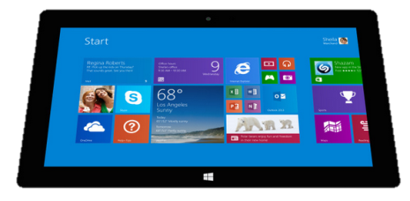
Regardless of paradigm
the content is the same
Receive a lab result in a message…
FHIR
Repository
FHIR Message
FHIR Document
Lab System
REST
National
Exchange
…Package it in a discharge summary document

Slide 43

Architectures
FHIR makes no assumptions about the architectural design of systems
Notes:
FHIR makes no assumptions about the architectural design of systems
System architecture Jargon words – it still doesn’t matter.
Light or heavy clients
Central server or peer-to-peer sharing
Push or pull
Query or publish/subscribe
Loosely coupled or tightly coupled environments
With history tracking or without

Slide 44
Architectures
FHIR makes no assumptions about the architectural design of systems
You can use it for
Light or heavy clients
Central server or peer-to-peer sharing
Push or pull
Query or publish/subscribe
Loosely coupled or tightly coupled environments
With history tracking (versions) or without
Notes:
More on this later…

Slide 45
Some possible architectures
v3
v2
App
FHIR
FHIR
Broker
PHR
Interface
FHIR
DB
Notes:
You’re a message broker routing and translating between v2, v3 and FHIR
Your app interfaces with a PHR using FHIR natively
Your application can communicate using FHIR, but your software uses a proprietary RDBMS
Use FHIR as the common language for a Vendor Neutral Archive
…Or a combination….
You might see data as a nested structure of XML, a series of tables with keys, class-diagrams….

Slide 46
Repository model
HIS
LIS
PACS
PMS
FHIR
FHIR
FHIR
FHIR
Vendor Neutral Repository
Vendor Neutral Repository
FHIR
FHIR
openEHR
RLS

Slide 47
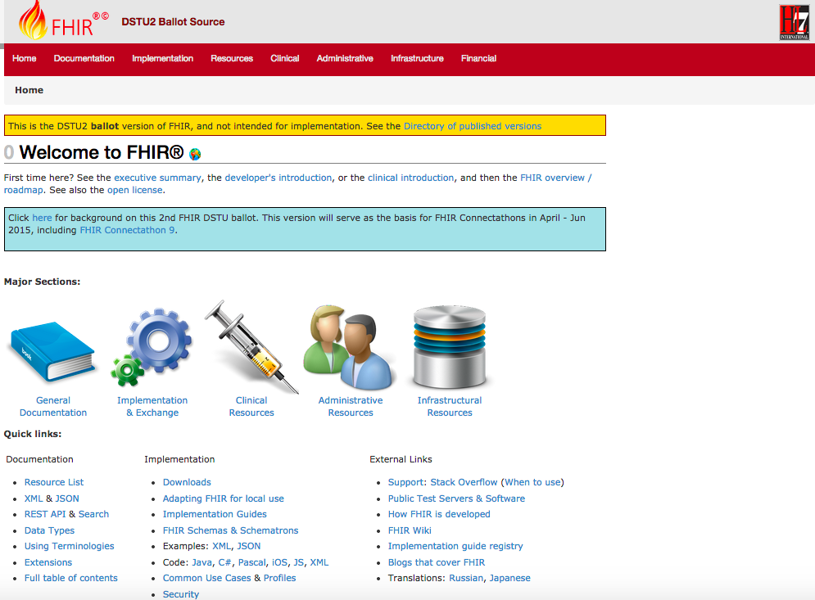
DSTU 2
DSTU-2
Notes:
Published as HTML
Published using validation process that performs consistency checks – like a software build
Really shouldn’t require much guidance to read, but a few things to call out
Objective of spec is developer can skim and decide in < day

Slide 48
2 aspects to FHIR
Content
Resources (the model)
Informed by much past work inside & outside of HL7
HL7: version 2, version 3 (RIM), CDA
Other SDO: openEHR, CIMI, ISO 13606
Others: IHE, DICOM
Profiling & the 80%
Exchange protocols - Paradigms
API
Other paradigms
Message, Document

Slide 49
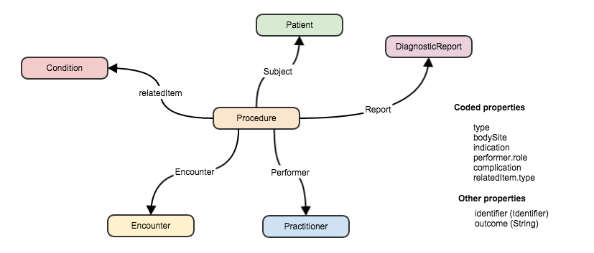
FHIR Resources
FHIR resource
“container” of information that represent something in the real world
Link between resources
Notes:
Resources” are: “data model” containers if information that represent something in the real world = patient, test result, prescription
Small logically discrete units of exchange
Defined behaviour and meaning
Known identity / location
Smallest unit of transaction “of interest” to healthcare
V2: Sort of like Segments
V3: Sort of like CMETsExample of network of resources using references within Procedure.
Besides Increases re-use….
Lighter-weight communication: Can create a ‘network’ of interrelated resources through referencing rather than sending all the data - other examples with clinFHIR - NutritionOrder, DiagnosticReport.
Also Aligns well with how data is stored

Slide 50
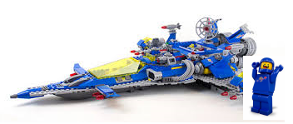
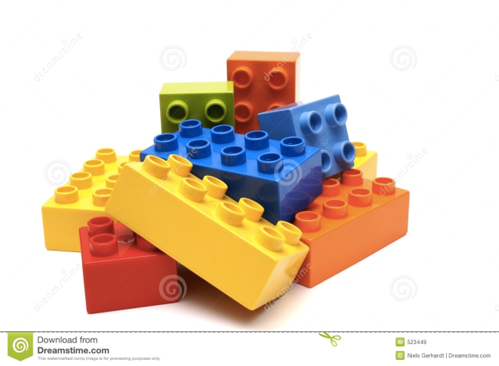
Resources
Notes:
Resources” are: “data model” containers if information that represent something in the real world = patient, test result, prescription
Small logically discrete units of exchange
Defined behaviour and meaning
Known identity / location
Smallest unit of transaction “of interest” to healthcare
V2: Sort of like Segments
V3: Sort of like CMETs
What are those legos doing there....
Remind us that resources Increases re-use ( like lego blocks )
Can use the same resource structures (and profiles on them) and instances in many solutions.

Slide 51
What’s a Resource?
Examples
Non-examples
Administrative
Patient, Practitioner, Organization, Location, Coverage, Invoice
Clinical Concepts
Allergy, Condition, Family History, Care Plan
Infrastructure
Document, Message, Profile, Conformance
Gender
Too small
Electronic Health Record
Too big
Blood Pressure
Too specific
Intervention
Too broad
100-150 total - ever
Notes:
And few systems will ever see more than 40-50
Go back and review the categories… before looking at some resource instances in detail.

Slide 52
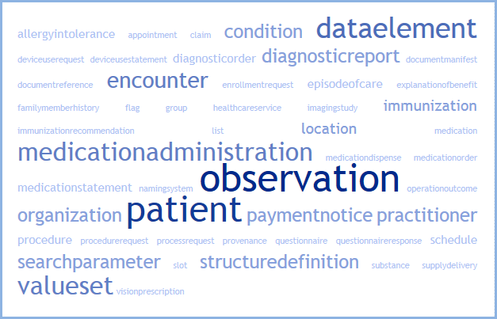
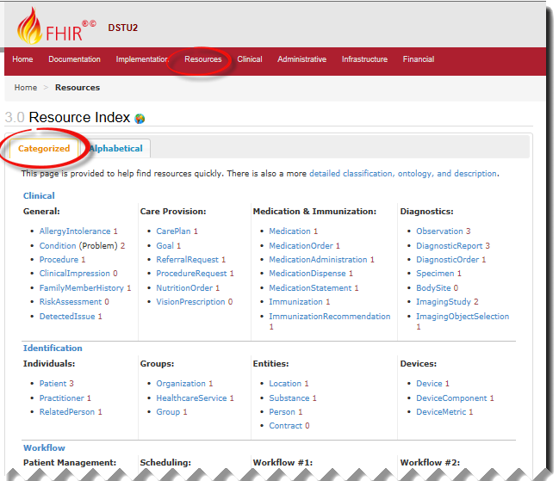
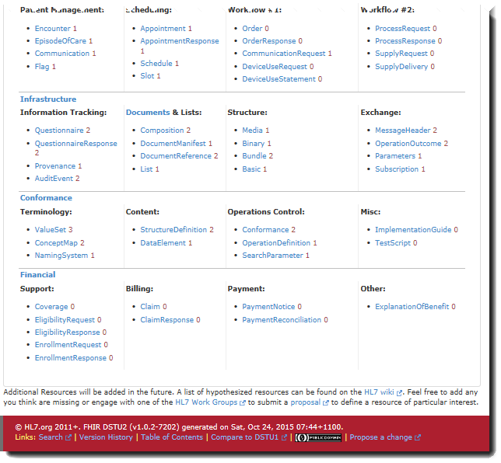
FHIR Resources
Notes:
Categories:
Clinical ( Observation, Condition, MedicationAdministratiion, Procedure) ,
Administrative ( Patient, Provider, Organization )
Workflow ( Appointment, Order, various “request” resources )
Infrastructure (Bundle, List, Composition ( Documents ), Provenance
Conformance ( ValueSet, Conformance )
Financial
The top 50 (commonly Posted ) resources instances on a sampling of publicly availableFHIR Servers. Out of 94
100-150 total - ever

Slide 53
Why resources?
Increases re-use
Can use the same resource structures (and profiles on them) in many solutions
Lighter-weight communication
Can create a ‘network’ of interrelated resources through referencing rather than sending all the data
Aligns well with how data is stored
Notes:
Re-use – see legos analogy. Kind of a basic unit of exchange.
Light weight communication. – links create an interconnected web of resources. See examples
What

Slide 54
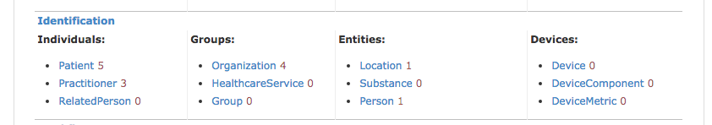
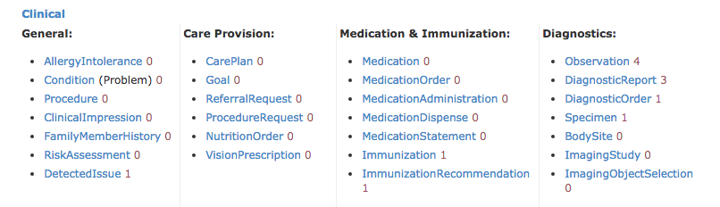
Resources - I

Slide 55
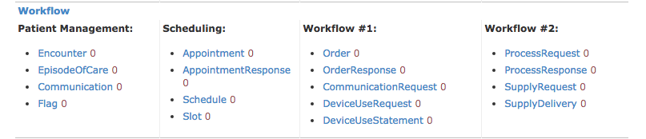
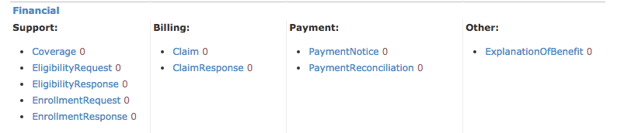
Resources - II

Slide 56
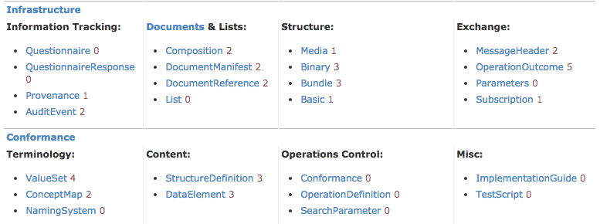
Resources - III

Slide 57
Detailed look at a FHIR Resource
For each Resource:
Scope and Usage Notes
Resource Content (UML and XML)
Terminology Bindings
Constraints
Implementation Issues
Search Parameters
Examples, Profiles, Formal Definitions
Mappings to RIM, CDA, v2, etc
Notes:
View a resource in more detail…
Show in spec how get to any resource in 2 clicks

Slide 58
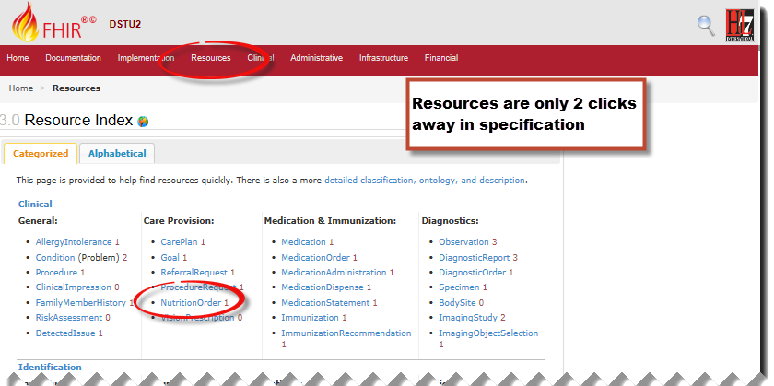
Detailed look at a FHIR Resource

Slide 59
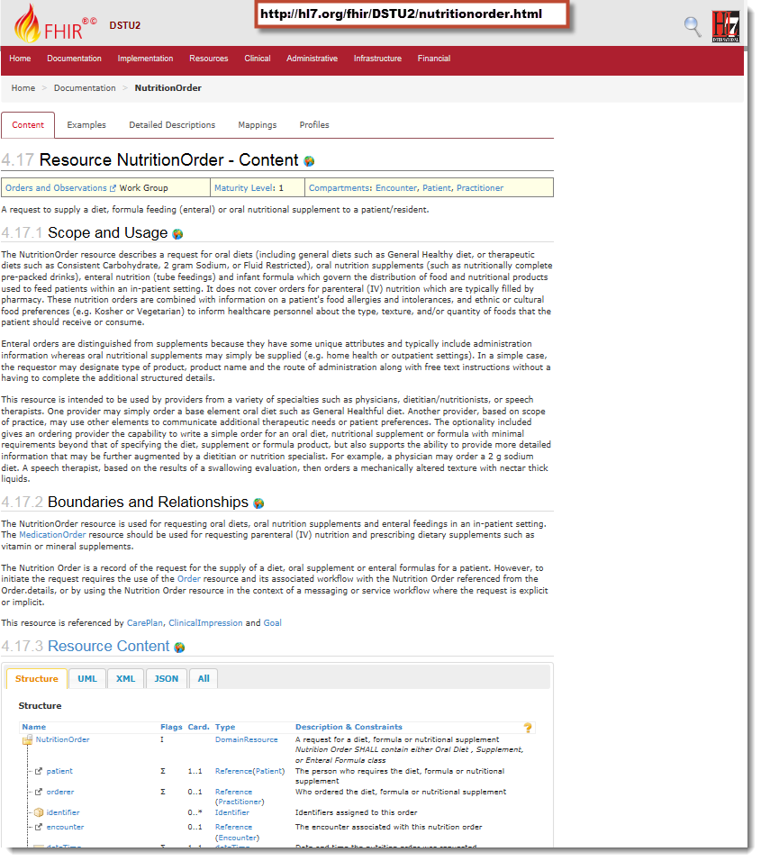


Notes:
For each Resource:
*Scope and Usage Notes
*Resource Content (UML and XML)
Terminology Bindings
Constraints
Implementation Issues
Search Parameters
*Examples, Profiles, Formal Definitions
*Mappings to RIM, CDA, v2, etc

Slide 60
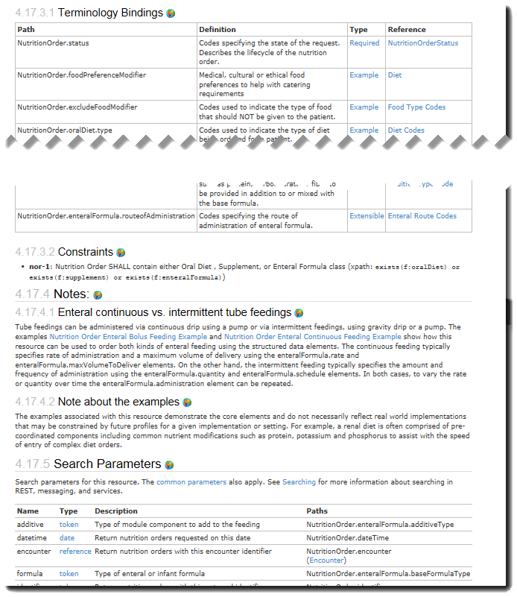
Notes:
For each Resource:
Scope and Usage Notes
Resource Content (UML and XML)
*Terminology Bindings
* Constraints
* Implementation Issues
*Search Parameters
Examples, Profiles, Formal Definitions
Mappings to RIM, CDA, v2, etc

Slide 61
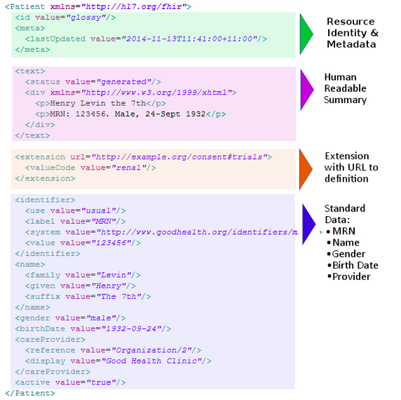

Slide 62
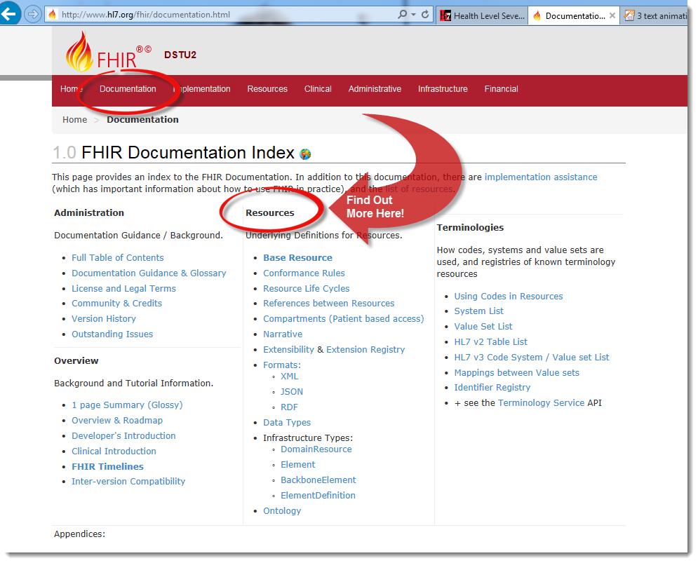
Resources
Notes:
Resources” are: “data model” containers if information that represent something in the real world = patient, test result, prescription
Small logically discrete units of exchange
Defined behaviour and meaning
Known identity / location
Smallest unit of transaction “of interest” to healthcare
V2: Sort of like Segments
V3: Sort of like CMETs
What are those legos doing there....
Remind us that resources Increases re-use ( like lego blocks )
Can use the same resource structures (and profiles on them) and instances in many solutions.

Slide 63
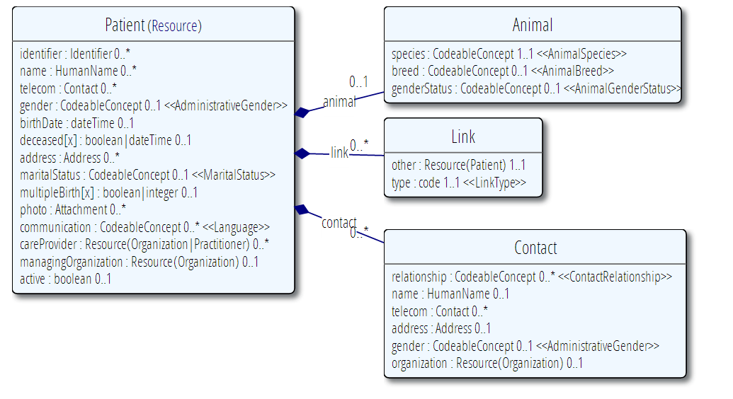
Example Content Definitions: UML Representation
Notes:
4 different way to represent content in specification:
Showing UML
Also tree structure,XML, JSON (RDF is soon to come?)

Slide 64
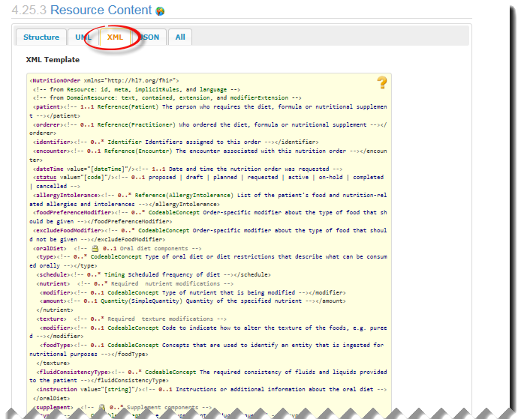
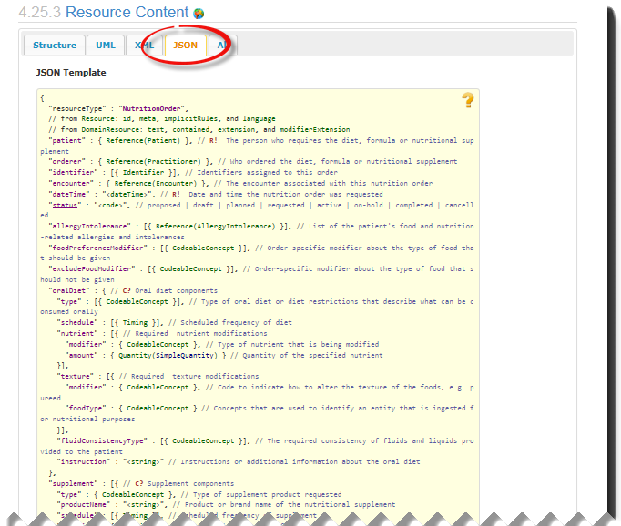
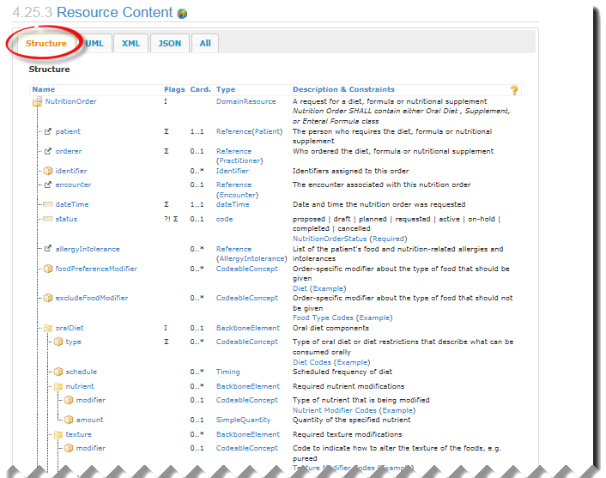
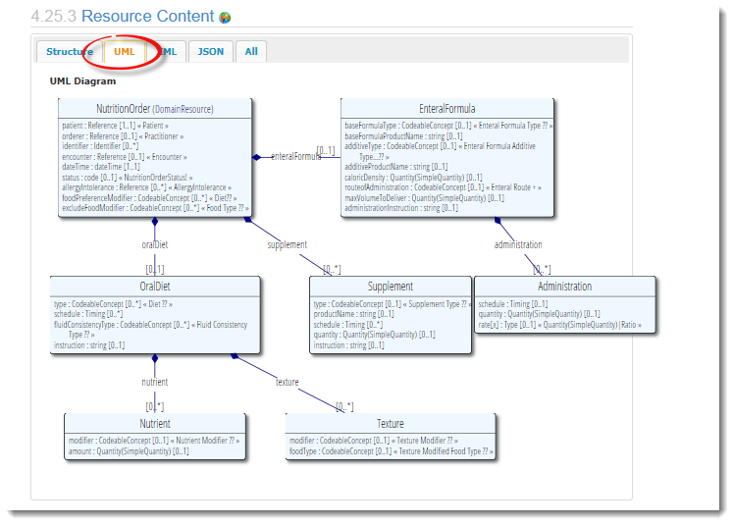
Example Content Definitions: Multiple Representations
Notes:
4 different way to represent content in specification:
Showing UML
Also tree structure,XML, JSON (RDF is soon to come?)

Slide 65
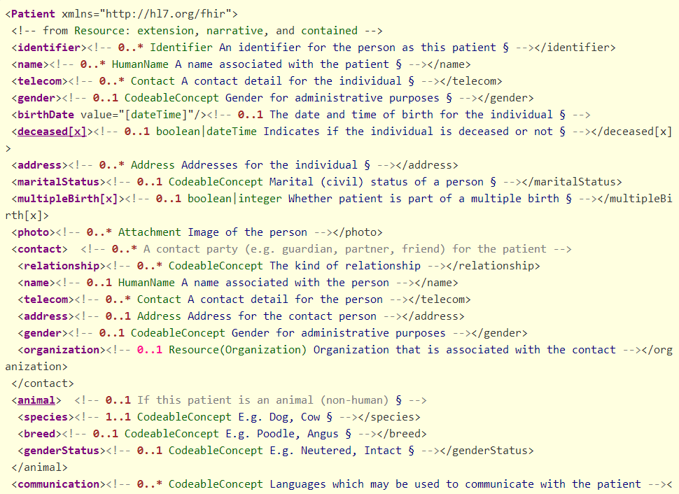

Slide 66
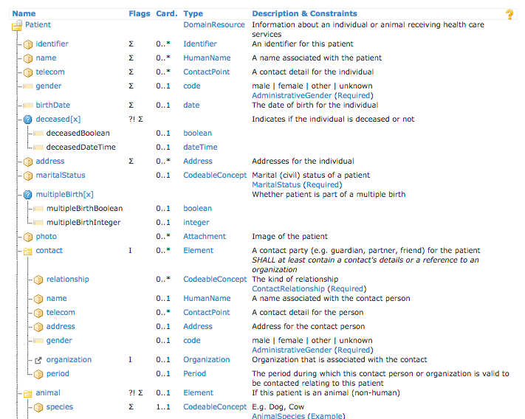

Slide 67
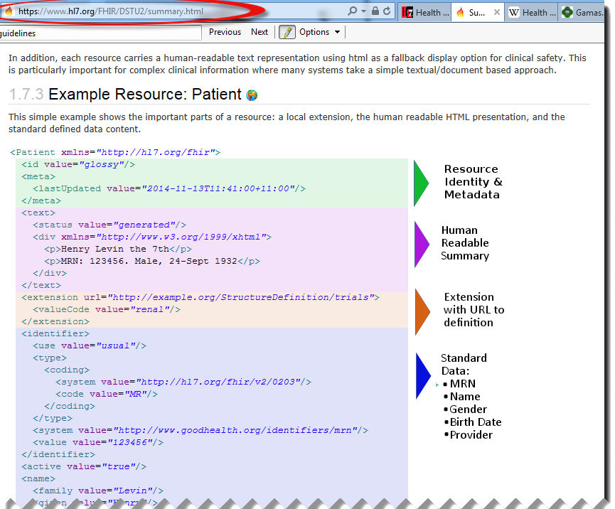

Anatomy of a Resource
Notes:
Focus on the Resource Content Defined Structured Data
The logical, common contents of the resource
Each Resource is composed of about 20-40 resource elements example instances to follow
Mapped to formal definitions/RIM & other formats ( need a screen shot of this)
Extensions
“Non-common” requirements, but everyone can use
Published and managed
Narrative
Human readable (fall back)
Metatata including the resource id ( how to find it on or refer to it) tags, history/versioning

Slide 68
Resource Element
Each Resource is composed of about 20-40 resource “elements”
Each resource element is defined by:
Name
Cardinality
Type (Data type or structural resource)
Description
Terminology Binding
Other stuff (Comments,Constraints, Summary Flags, mappings, etc)
Notes:
Each Resource is composed of resource elements. These element can be structural or define a particular Data element.

Slide 69
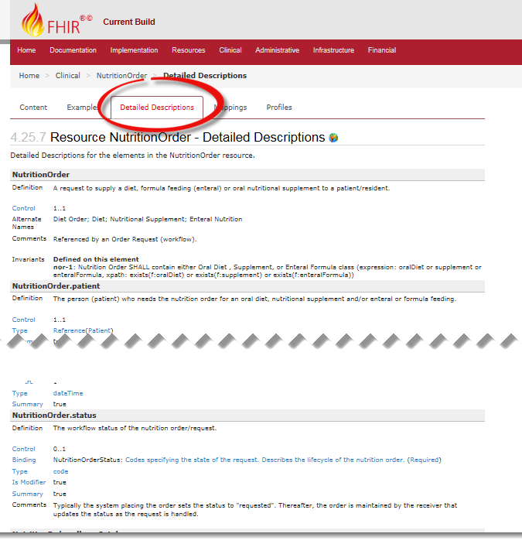

Resource Element Example
Notes:
Each resource element is defined by:
Name
Cardinality
Type (Data type or structural resource)
Description
Terminology Binding
Other stuff (Comments,Constraints, Summary Flags, mappings, etc)

Slide 70
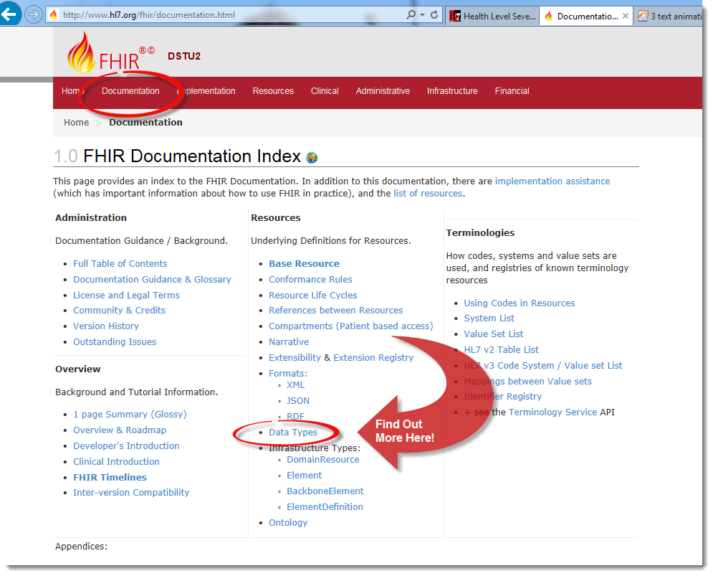
Data types
Notes:
Based on w3c schema and ISO data types
Stick to the “80% rule” – only expose what most will use
Simplified

Slide 71
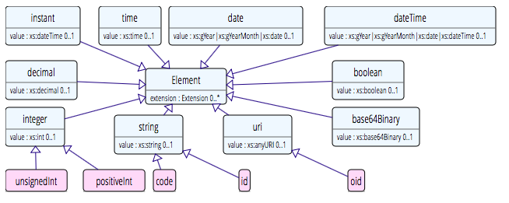
Data types:Primitive
Based on w3c schema and ISO data types
Stick to the “80% rule” – only expose what most will use
Simplified

Slide 72
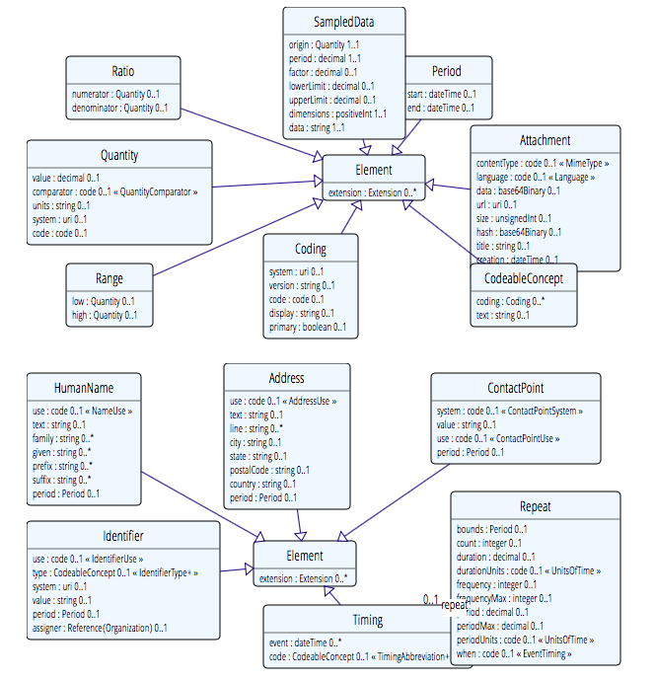
Complex
Notes:
Complex meaning composed of other datatypes - example identifer, codeableConcept

Slide 73
Example – CD datatype
ISO
Code, code system, code system name, code system version, value set id, value set version, coding rationale, updateMode, flavorId, nullFlavor, controlAct root & extension, validTime low and high
displayName with language and translations
originalText with mediaType, language, compression, integrityCheck, thumbnail, description, translations, reference (can be text, video, whatever)
Translations (most of same info as code)
Source code

Slide 74
Example – CD datatype
FHIR
Code, code system, code system name, code system version, value set id, value set version coding rationale, updateMode, flavorId, nullFlavor, controlAct root & extension, validTime low and high
displayName with language and translations
originalText with mediaType, language, compression, integrityCheck, thumbnail, description, translations, reference (can be text, video, whatever)
Translations (most of same info as code)
Source code

Slide 75
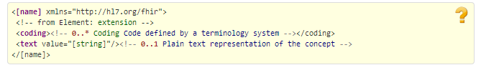
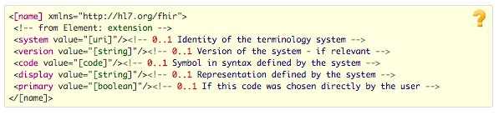
CodeableConcept
CodeableConcept
Coding
Notes:
Look at the data type for coded data “codeableConcept” in depth

Slide 76
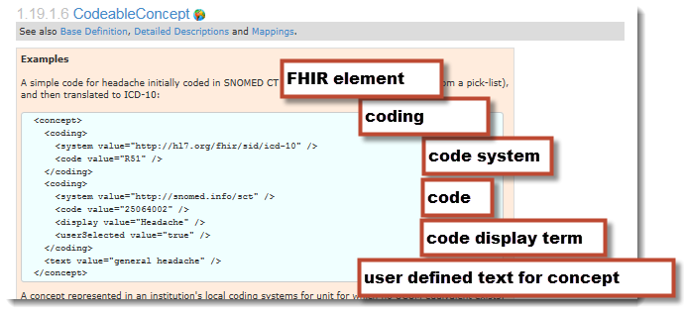
CodeableConcept: Example
Notes:
Example instance in XML: and general pattern for coded data.

Slide 77
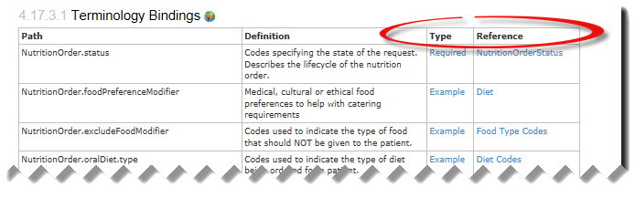
Bindings
Notes:
Binding Strength
Code Systems and ValueSets ( more slides on this if time)

Slide 78
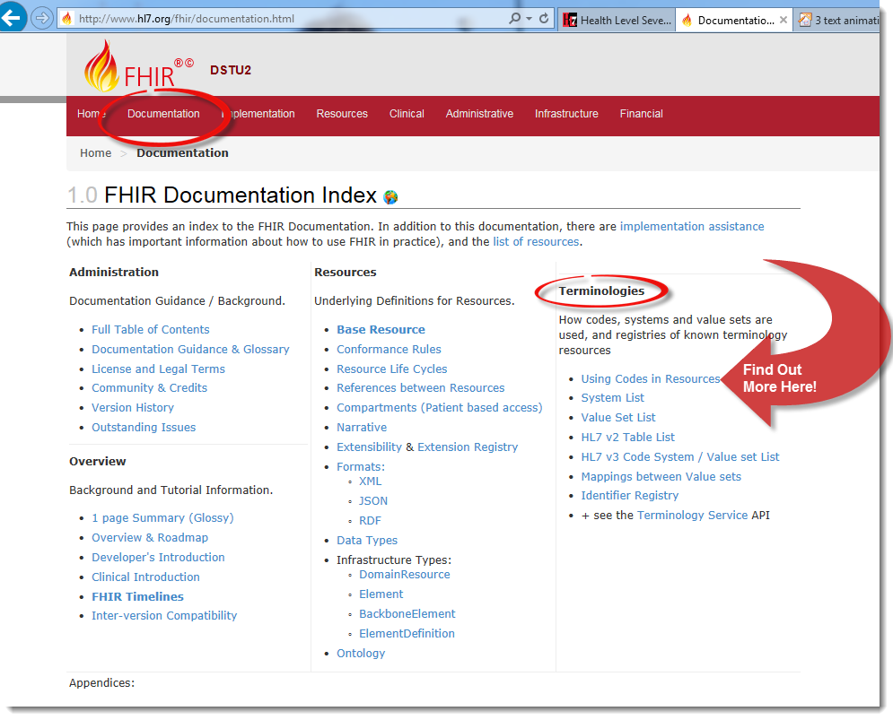
Bindings
Notes:
Binding Strength
Code Systems and ValueSets – more about vocabulary in other slides depending on time.

Slide 79
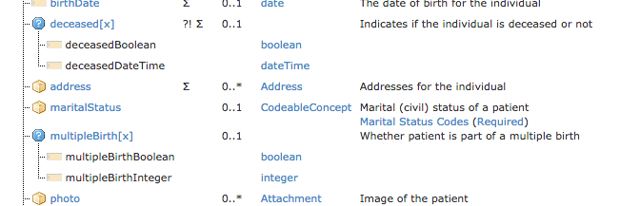
Polymorphic Properties
Where a property can have different datatypes
Can use a profile to restrict to specific type
To come!

Slide 80
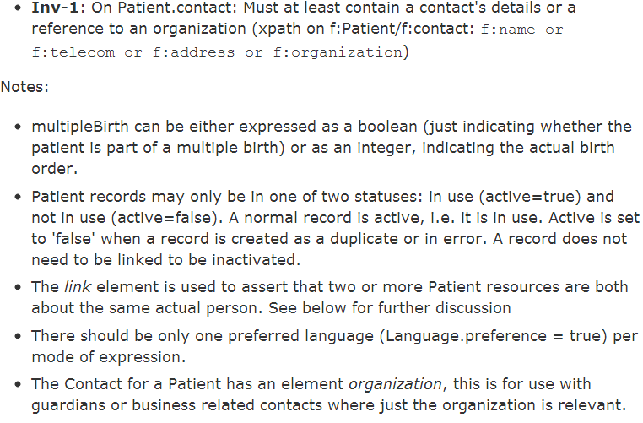
Constraints & Notes

Slide 81
Resource Identifiers
2 different ‘sorts’ of identity
ID identifies a resource on a server
Is Metadata
Will change between servers
Identifier
Business identifier
Is an element in the resource
Notes:
See example of business identifer

Slide 82
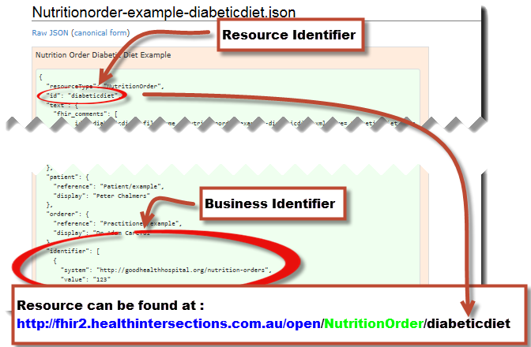
A Resource’s ID Example
Notes:
This is not only the URL you use to retrieve the resource, it’s also its id.
All URL’s in FHIR are case-sensitive (and so is the id)

Slide 83
A Resource’s ID
http://server.org/fhir/Patient/1
resource type
endpoint
id
Note: This URL resolves to the current version of a resource
It’s also specific to a server
Notes:
This is not only the URL you use to retrieve the resource, it’s also its id.
All URL’s in FHIR are case-sensitive (and so is the id)

Slide 84
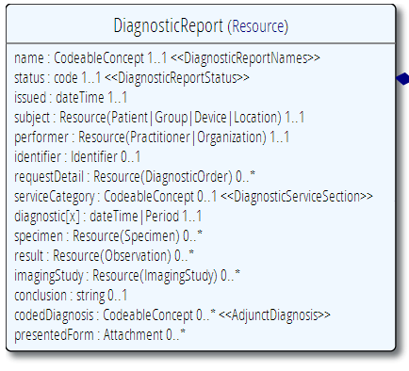

“Business” identifiers
Notes:
Resource Id’s (=URLs) are infrastructural id’s, they differ from “business” identifier.
Many Resources also have business identifiers, they are explicitly modeled, like Patient.identifier (even more than one identifier possible!)
Business identifiers are completely separate from technical resource id’s

Slide 85
It’s all about combining resources . . .
http://lab.hospitalA.org/Observation/3ff27
http://moh.govt.nz/nhi/Patient/223
Observation
Patient
Diagnostic
Report
Organization
http://lab.hospitalA.org/DiagRep/4445
Practitioner
http://moh.govt.nz/hpi/Organization/1
http://moh.govt.nz/hpi/Practitioner/87

Slide 86
References between Resources
FHIR resource
“container” of information that represent something in the real world
Link between resources
Notes:
Can create a ‘network’ of interrelated resources through referencing rather than sending all the data. By resources referencing each other extensively they form a web of information.

Slide 87

References between Resources
Notes:
Resources” are: “data model” containers if information that represent something in the real world = patient, test result, prescription
Small logically discrete units of exchange
Defined behaviour and meaning
Known identity / location
Smallest unit of transaction “of interest” to healthcare
V2: Sort of like Segments
V3: Sort of like CMETsExample of network of resources using references within Procedure.
Besides Increases re-use….
Lighter-weight communication: Can create a ‘network’ of interrelated resources through referencing rather than sending all the data - other examples with clinFHIR - NutritionOrder, DiagnosticReport.
Also Aligns well with how data is stored

Slide 88
References
Resources are independent – don’t need other resources to correctly interpret a resource
But resources reference each other extensively to form a web of information
Need to resolve references to fully understand the data
<Procedure xmlns="http://hl7.org/fhir">
<subject>
<reference value="Patient/23"/>
</subject>
…
<report>
<reference value=”http://myServer/DiagnosticReport/45"/>
</report>
…
Notes:
Individual resource should be able to “stand alone” they do not conduct information from other resource - through an implied context.
Note on API Exchange- the FHIR API defines that a given relative endpoint must always behave the same way. Like copying your file system on your hard drive to everybody else … is always going to be the same. So /Patient exists on every FHIR servers ( that supports Patient) and that is where the patient resources is stored.
See example resource Snippet in XML
Same in JSON
"patient": {
"reference": "Patient/example",
"display": "Peter Chalmers"
},
"orderer": {
"reference": "Practitioner/example",
"display": "Dr Adam Careful“
},
Other referencing rules

Slide 89
Rules for references
References can be relative or absolute
References don’t have to be to the same server
Server does not have to enforce integrity
Clients need to cater for broken links
Targets can be ‘contained’ in the resource:
<Procedure xmlns="http://hl7.org/fhir">
<contained>
<Patient id="pat">
</Patient>
</contained>
<subject>
<reference value="#pat"/>
</subject>

Slide 90
Narrative
All resources can carry an html representation of their content
It’s a clinical safety issue
The receiver has a fall back option if the system is not sure it fully understands the content
It is not mandatory, but SHOULD be present
In a closed eco-system, with extremely tight control and strong conformance testing, it may not be necessary
But things often change over time
So using narrative is highly recommended
Notes:
Saves a lot of money downstream from the author

Slide 91
Narrative
Notes:
Narrative
Human readable (fall back)
All resources can carry an html representation of their content
It’s a clinical safety issue
The receiver has a fall back option if the system is not sure it fully understands the content
It is not mandatory, but SHOULD be present
In a closed eco-system, with extremely tight control and strong conformance testing, it may not be necessary
But things often change over time
So using narrative is highly recommended

Slide 92
Narrative XHTML
Narrative is XHTML. Formatting allowed:
Tables, lists, divs, spans
Bold, Italics, styles etc
E.g. all static content
Features not allowed:
Objects, scripts, forms – no active content
Links, Stylesheets, iframes – web context
Local storage, Microdata (no active content)
Concerns are security and clinical safety

Slide 93

Narrative XHTML
Notes:
Narrative is XHTML. Formatting allowed:
Tables, lists, divs, spans
Bold, Italics, styles etc
E.g. all static content
Features not allowed:
Objects, scripts, forms – no active content
Links, Stylesheets, iframes – web context
Local storage, Microdata (no active content)
Concerns are security and clinical safety

Slide 94

Narrative example
Notes:
Resources SHOULD always contain narrative to support human-consumption as a fallback. However, in a strictly managed trading systems where all systems share a common data model and additional text is unnecessary or even a clinical safety risk, the narrative may be omitted.
generated The contents of the narrative are entirely generated from the structured data in the resource.
extensions The contents of the narrative are entirely generated from the structured data in the resource and some of the content is generated from extensions.
additional The contents of the narrative contain additional information not found in the structured data.
empty the contents of the narrative are some equivalent of "No human-readable text provided for this resource".

Slide 95
Visualizing FHIR
TextEditor, XML editor, FHIR Notepad++ Plugin
(David Hay’s) clinFHIR tool
Educational tool
For non-techies (especially clinicians & BA)
Beta software!
Resource Builder
View Resources
Create Condition
http://clinfhir.com/
Notes:
FHIR Notepad++ Plugin: http://www.healthintersections.com.au/FhirServer/fhirnpp.htm
ClinFHIR : http://clinfhir.com/
We are going to use this today. Maybe also with Notepad plugin as well.

Slide 96
Vocabulary
Support for coded data of varying complexity
Some codes defined as part of resource, others referenced from external vocabularies
LOINC, SNOMED, UCUM, etc.
Recognition some will differ by implementation space
Can use Value Set resource to define more complex or specific code lists

Slide 97
Terminology
a discipline that systematically studies the “labeling or designating of concepts” particular to one or more subject fields or domains of human activity
Wikipedia

Slide 98
FHIR Data Types for Coded Data
Resource element datatypes of different ‘categories’
Non-coded data
Coded data
Code
Coding
CodeableConcept
(Quantity)

Slide 99
Examples
Code: "status" : "confirmed"
Coding: { "system": "http://www.nlm.nih.gov/research/umls/rxnorm", "code": "C3214954", "display": "cashew nut allergenic extract Injectable" }
CodeableConcept: { "coding": [{ "system": "http://snomed.info/sct", "code": "39579001", "display": "Anaphylactic reaction“ }], "text" : "Anaphylaxis" }

Slide 100
Terminology Sub-system
Code System:
Defines a set of concepts with a coherent meaning Code Display
Definition
SNOMED CT / LOINC / RxNORM
HGVS, ICPC, MIMS + 100s more
ICD-X+
ANZSCO, METEOR
A drug formulary
A config table in an application
A list of enums in a java class
Australian state codes

Slide 101
Terminology Sub-system
Code System:
Defines a set of concepts with a coherent meaning Code Display
Definition
Value Set:
A selection of a set of codes for use in a particular context
Selects
Notes:
Eg condition with different specialties

Slide 102
Terminology Sub-system
Code System:
Defines a set of concepts with a coherent meaning Code Display
Definition
Value Set:
A selection of a set of codes for use in a particular context
Element Definition: Type and Value set reference
Binds
Selects

Slide 103
Terminology Sub-system
Code System:
Defines a set of concepts with a coherent meaning Code Display
Definition
Value Set:
A selection of a set of codes for use in a particular context
Element Definition: Type and Value set reference
Binds
Selects
Conforms
Element: code/ Coding/ CodeableConcept
Refers to

Slide 104
Binding Strength
How closely the options in the value set should be followed
Values
Required (must come from set)
Extensible (may use alternate if have to)
Preferred (don’t have to, but should)
Example (set isn’t specified)
Can use extension to vary
(Make stronger not weaker)

Slide 105
ValueSet resource
Defines list of possible values for a particular context
Can reference external Terminology/s
Or define own sets
Why?
A common valueSet improves recording consistency
Improves user experience (pick lists)
Examples in New Zealand
ED diagnoses (derived from SNOMED)
NZ POCS (Pathology Observation Code Set) (derived from LOINC)
List of NZ Iwi (defined in ValueSet)

Slide 106
ValueSet for condition.code
{
"resourceType": "ValueSet",
"id": "valueset-condition-code",
"meta": {
"versionId": "1",
"lastUpdated": "2015-05-08T16:18:23Z",
},
"text": {
"status": "generated",
"div": ”Condition.code sample ValueSet"
},
"url": "http://hl7.org/fhir/vs/condition-code",
"version": "0.5.0",
"name": "Condition/Problem/Diagnosis Codes",
"publisher": "FHIR Project team",
"contact": [
{
"telecom": [
{
"system": "url",
"value": "http://hl7.org/fhir"
}
]
}
],
"description": "Example value set for Condition/Problem/Diagnosis codes",
"copyright": "This value set includes content from SNOMED CT, which is copyright © 2002+ International Health Terminology Standards Development Organisation (IHTSDO), and distributed by agreement between IHTSDO and HL7. Implementer use of SNOMED CT is not covered by this agreement",
"status": "draft",
"experimental": true,
"compose": {
"include": [
{
"system": "http://snomed.info/sct",
"filter": [
{
"property": "concept",
"op": "is-a",
"value": "404684003"
}
]
}
]
}
}

Slide 107




Terminology Server
Provides ‘services’ for consumers to access terminology
Hide the complex stuff from a consumer
Uses Operations framework
Get definition for a concept
Find a concept
Within a ValueSet
Find Terms
Get Term Definition
http://hl7.org/fhir/2015May/terminology-service.html
Notes:
Expand
http://fhir-dev.healthintersections.com.au/open/ValueSet/valueset-condition-code/$expand?filter=diabetes
Lookup
http://fhir-dev.healthintersections.com.au/open/ValueSet/$lookup?system=http://loinc.org&code=8480-6

Slide 108
Exercise: Using a Terminology Server
clinFHIR
Resource builder (Condition)
Condition.code
Explore data set
Direct REST query from filter

Slide 109
resource miscellanous topics
Notes:
10:15

Slide 110
Tags
Contain metadata about resources
Beyond ID, version & date
Used for different purposes:
Compliance to Profile
Security – e.g. sensitivity of resource
User defined
Transported in different ways:
REST – as an HTTP header
In a bundle (document, message, transaction) - in the metadata element of the resource or the bundle
Notes:
Indicate Document/Message removed as bullet since no longer true.

Slide 111
Versioning
Most recent version
http://server.org/fhir/Patient/1
Returns single resource
All versions
http://server.org/fhir/Patient/1/_history
Returns bundle of versions
Specific version
http://server.org/fhir/Patient/1/_history/1
Returns single resource
Version support is optional
Notes:
Works at instance and type level – originally there

Slide 112
Version history – and revival
33, v13 – 2012-12-05
/server.org/fhir/Patient/33/_history/13
33, v14 – 2012-12-08
/server.org/fhir/Patient/33/_history/14
33, v15 – 2012-12-09
/server.org/fhir/Patient/33/_history/15
33, v16 – 2012-12-10
/server.org/fhir/Patient/33/_history/16
33, v17 – 2012-12-11
/server.org/fhir/Patient/33/_history/17
/server.org/fhir/Patient/33
Notes:
* The resource returns back to life!

Slide 113
Bundles
When more than one resource needed
Query result
Document
Message
Transaction
Specific Resource

Slide 114

Bundles
Notes:
Where to get more information on Bundles….

Slide 115

Bundle as a serialized Object Graph
Notes:
Imagine that all resources in a single bundle
Links maintain references

Slide 116
Contained Resources
When there is no external identity
Has limitations
No reuse
Very hard to ‘resolve’ to ‘real’
Use when you have to
Notes:
Reuse – example of practitioner- in encounter – name change

Slide 117

Resource Exchange via FHIR RESTful API

Slide 118
REST in practice
“Resources” with an explicit and stable URI
The name for what gets exchanged in REST
Defined behaviour and meaning
Known identity / location
Quite an abstract idea
Formats: XML / JSON / RDF
Exchange using HTTP
Security: SSL / OAuth
“REST” followed loosely, hence “RESTful”
Notes:
FHIR Resources are a representation of “something” in healthcare

Slide 119
REST Operations
CRUD:
Create – create a new instance of data
Read – get the content (state) of an instance of data
Update – change the content of an instance of data
Delete – remove the instance of data
Notes:
Delete isn’t necessarily physical
Execute – eg transaction

Slide 120

FHIR RESTful Interactions
Notes:
Description of interactions
If >1 then wrapped in a bundle resource.
Can specify fomat by using _format parameter or headers for XML/JSON
Examples:

Slide 121
FHIR RESTful - Syntax
Instance
Read GET [base]/Patient/100
Vread GET [base]/Patient/100/{vid}
Update PUT [base]/Patient/100
Delete DELETE [base]/Patient/100
History GET [base]/Patient/100/_history
Type
Create POST [base]/Patient
Search GET [base]/Patient?name=eve
History GET [base]/Patient/_history
Validate POST [base]/Patient/100/_validate/{id}
System
Conformance GET [base]/metadata
Transaction POST bundle to root
History GET [base]/_history
Search GET [base]/Patient?name=eve
Notes:
Basic syntax for each Restful transaction.
base is server endpoint.
If >1 then wrapped in a bundle resource.
Can specify fomat by using _format parameter or headers for XML/JSON
Examples:

Slide 122

FHIR RESTful Search
Notes:
Searching for resources is fundamental to the mechanics of FHIR.
Search operations traverse through an existing set of resources filtering by parameters supplied to the search operation.

Slide 123




FHIR RESTful Search
Notes:
Searching for resources is fundamental to the mechanics of FHIR.
Search operations traverse through an existing set of resources filtering by parameters supplied to the search operation.
In the simplest case, a search is executed by performing a GET operation in the RESTful framework: Functionally, this is equivalent to a simple read operation:
Each search parameter is defined by a type that specifies how the search parameter behaves. These are the defined parameter types:
Number Search parameter SHALL be a number (a whole number, or a decimal).
Date Search parameter is on a date/time. The date format is the standard XML format, though other formats may be supported.
String Search parameter is a simple string, like a name part. Search is case-insensitive and accent-insensitive. May match just the start of a string. String parameters may contain spaces.
Token Search parameter on a coded element or identifier. May be used to search through the text, displayname, code and code/codesystem (for codes) and label, system and key (for identifier). Its value is either a string or a pair of namespace and value, separated by a "|", depending on the modifier used.
[parameter]=[code]: the value of [code] matches a Coding.code or Identifier.value irrespective of the value of the system property
Reference A reference to another resource.
Composite A composite search parameter that combines a search on two values together.
Quantity A search parameter that searches on a quantity.
Uri A search parameter that searches on a URI (RFC 3986).

Slide 124
Playing with FHIR
Access public server using
Browser can be used for Read
Developer Tools to Create and Update
Curl – command line tool
Fiddler, Postman and other applications
ClinFHIR, NotePad++ Plugin
Applications
Smart Clients
Notes:
Sample CRUD stuff using Curl
e.g.
GET
>curl http://fhirtest.uhn.ca/baseDstu2/Patient/1
Add –I optino to display headers for transaction response (e.g. 200, 201)
>curl –i http://fhirtest.uhn.ca/baseDstu2/Patient/1
History
>curl http://fhirtest.uhn.ca/baseDstu2/Patient/1_history
Create (RESTful HTTP POST)
curl -d @filename --header "Content-Type: text/xml“ http://hostname/resource (--header "Content-Type: text/json“ )
>curl –i –X POST --header "Content-Type: text/xml“ -d @file.xml http://fhirtest.uhn.ca/baseDstu2/Observation
Update /Create (RESTful HTTP PUT)
curl --upload-file filename --header "Content-Type: text/json“ http://hostname/resource/id
>curl –X PUT --header "Content-Type: application/json“ –d @file.json http://fhirtest.uhn.ca/baseDstu2/Patient/example
Search for Observation(s) with LOINC code
GET [base]/Observation?code=[LOINC]
>curl –i http://fhirtest.uhn.ca/baseDstu2/Observation/?code=3141-9
.
Search for patient on name
Specify json or xml
Get a patient
Update a patient
Grahames & Ewouts server

Slide 125

FHIR Operations

Slide 126
RPC (Operations) vs REST
RPC (Remote Procedure Call):
Ask a server to perform some operation
Hand it a set of parameters
Server performs some operations
Returns a set of parameters
REST:
Define a URI that represents the state of something
Tell the server what the state should be
Server makes the state change happen

Slide 127
RPC vs REST example
Example:
A device that monitors a patient %0₂ Sat
Raises an alarm on EHR if it’s too low
EHR can turn the alarm off
RPC:
POST http://acme.org/devices/turnOffAlarm
Parameters: device id, alarm id
REST:
POST http://acme.org/devices/[deviceid]/[alarmid]
Content: data to say “Alarm is off”

Slide 128

FHIR Operations

Slide 129

Profiles & conformance
Notes:
10:15

Slide 130
The need for Profiles
Many different contexts in healthcare, but a single set of Resources
Need to be able to describe restrictions based on use and context
Allow for these usage statements to:
Authored in a structured manner
Published in a repository
Used as the basis for validation, code, report and UI generation.
Note Profiling is going to be very important
‘Message from the chair’

Slide 131
The need for Profiles
Profiles can serve the same purpose as:
CDA templates & implementation guides
HL7 v2 “static” profiles
CIMI implementation guides
OpenEHR Archetypes & templates
Profiles aren’t mandatory for interoperability, but they improve the degree of it.
Profiles never change meaning of an instance

Slide 132

Profiling a resource. For example...
Require that the identifier uses the NHI – and is required
Limit names to just 1 (instead of 0..*)
Limit maritalStatus to another set of codes that extends the one from HL7 international
Add an extension to support “Iwi”
Constrain out animal element(card = 0..0)
Notes:
Note: hardly any mandatory elements in the core spec!
Tools for creating profile being develop - Forge..

Slide 133

FHIR Extensions
Notes:
10:15

Slide 134
The Case for Extensions
Extensions are often problematic in existing HL7 specs
Z-segments in v2
What does this mean?
ZSB|20080117|Q^57|4.30^uL
Foreign namespaces in CDA/V3
Break schemas
Simple choice – design for absolutely everything or allow extensions

Slide 135
Extensions
FHIR has a standard framework for extensions
Built into wire format
Every FHIR element can be extended
Including datatypes
Every extension has:
Reference to a computable definition
Value – from a set of known types
Every system can read, write, store and exchange all legal extensions
All extensions are valid by schema etc.

Slide 136
Extensions
In FHIR, extensions are “normal”
Consequence of the 80% rule – keep the simple stuff simple
Extensions can exist anywhere
Resource, Element, DataType
Conformant systems can’t reject instances just because they contain unrecognized extensions
They could:
Display them
Should be in resource narrative
Store as a ‘Blob’
Make a conscious decision to ignore (unless ModifierExtension)
(Could lookup profile)
Notes:
[31/08/14 3:34:55 pm] Lloyd McKenzie: no. They can't refuse the instance because it contains extensions (unless they're modifierExtensions), but they're free to strip/ignore them.
[31/08/14 3:35:19 pm] Lloyd McKenzie: Requiring persistance would cause havoc with legacy systems

Slide 137
Extension Definition
Core part of profiling
(to come later)
A separate resource (was part of profile)
StructureDefinition
Also used for resource definition
Registries
Search before build
Promote reuse

Slide 138

An Extension in a resource

Slide 139

Extending a multiple birth
Key = location of formal definition
Value = value according to definition
Notes:
Really any FHIR element (Resource, Datatype, Primitive) can be extended. Just nest an <extension> element under the thing you want to extend
You should be able to go to the formal definition endpoint and get the definition of the extension.
Note: birth order is already provided for in FHIR through the multipleBirthInteger

Slide 140
Modifier Extensions
Also a core part of FHIR
Needed because some extensions can’t be safely ignored
Can’t compute on an element containing an unrecognized modifier extension. However, can:
Reject instance
Just display narrative
Retrieve definition & seek human review

Slide 141
Governing Extensions
Extensions are not a silver bullet
FHIR has a sliding scale governance for extensions
HL7 published extensions
National Standards (e.g. Standard Finnish Extensions)
Domain standards (e.g. Best Practice Cardiology)
Local Projects

Slide 142
Using Profiles
You can just go ahead and use a resource
No need for a profile
But you should write a profile
Document your usage in detail for partners
You can mark a resource or bundle with a profile
It’s just a claim – can test conformance with that
Notes:
Denormalization for performance
Comment that profiles will be really important

Slide 143
Tooling
Forge
Official profile creator
http://fhir.furore.com/forge
Go to the tutorial!
clinFHIR
An educational tool
Others will come…

Slide 144
Conformance
There’s a resource for documenting conformance to FHIR
Can be used for:
Stating how a specific system instance behaves
Defining how a software system is capable of behaving (including configuration options)
Identifying a desired set of behavior (e.g. RFP)
To declare themselves “FHIR Conformant”, a system must publish a Conformance instance
Notes:
Doesn’t have to support XML – is can be json only

Slide 145

Conformance (cont’d)

Slide 146
Implementing FHIR

Slide 147
Client responsibilities
Extensions
Especially modifier
Broken references
Contained resources
Profiles don’t change wire format

Slide 148
Where can FHIR be used?
Classic in-institution interoperability
Back-end e-business systems (e.g. financial)
Regional Health Information Organizations (RHIO)
National EHR systems
Social Web (Health)
Mobile Applications
Near
Term

Slide 149
Architecture
Standalone FHIR Server
A FHIR Server in front of an existing application (e.g. SQL)
FHIR as front end to an XDS server (“MHD”)
An interface engine that ‘speaks’ FHIR
A tablet/mobile phone application
Web portal uses FHIR to access other systems
A healthcare application that access information from multiple systems as well as it’s own server
Smart-On-FHIR – an EHR plug-in framework

Slide 150

Implementation Assistance
Notes:
Skype – implementers channel – 300 participants
Stack Overflow – ask implementation questions
Link from front page
Search for answers first
Don’t ask for changes to the spec (get deleted!)
gForge Tracker – ask for changes to the spec
Link from bottom of every page
But have discussion somewhere first
Disqus – on every page of the specification
FHIR Email list, Connectathons, Tutorials

Slide 151
Implementation Tools
Reference Implementations – object models, parsers, serializers, clients, validators, utilities
Schema, Schematron, Validation Pack
1000’s of examples

Slide 152
Test Servers
Use the servers to explore how it works
Write clients that use the test data
Test that you got your own system right
Most developers:
Use the servers to learn
Consult the documentation occasionally
We do recommend to read the specification
(RTFS)

Slide 153
Connectathons
Open invitation to any interested party to come and write software that exchanges FHIR resources
Always hold one before HL7 meetings (last week) + Others by invitation
Mix of skills
Newbies (“where is the spec?”)
Old hands who’ve been to every connectathon
Experiment with new features
We have a virtual connectathon all the time…

Slide 154
Implementation Assistance
Skype – implementers channel – 300 participants
Stack Overflow – ask implementation questions
Link from front page
Search for answers first
Don’t ask for changes to the spec (get deleted!)
gForge Tracker – ask for changes to the spec
Link from bottom of every page
But have discussion somewhere first
FHIR Email list, Connectathons, Tutorials

Slide 155



Implementation Assistance
Notes:
Skype – implementers channel – 300 participants
Stack Overflow – ask implementation questions
Link from front page
Search for answers first
Don’t ask for changes to the spec (get deleted!)
gForge Tracker – ask for changes to the spec
Link from bottom of every page
But have discussion somewhere first
FHIR Email list, Connectathons, Tutorials
See Wiki for details

Slide 156
Migration
No expectation that people will migrate existing interfaces any time soon.
Initial adopters will be green-field, new technology
FHIR may see use behind the scenes in v2 systems before it sees use over the wire
Forthcoming policy initiatives may necessitate revisiting existing interfaces

Slide 157
Migration – v2
Already have at least one integration engine that supports translation between v2 and FHIR
Resources map to segments reasonably well
As always, the challenge with v2 mapping is the variability of v2 interfaces
“Common” mappings can be created, but they won’t be one size fits all
Increasing focus

Slide 158
Migration – CDA
Made more complex by human-readable nature
Need to ensure text <-> entry linkages are retained
Will best be handled on a template by template basis
Start with well defined ones like C-CDA
Focus of DSTU-2
Argonaut
Notes:
12:15
Text linkages not as important when not human-attested

Slide 159
What’s next?

Slide 160
Development plans
Currently DSTU-2
Additional resources will continue to be introduced in future DSTU cycles as implementers identify needs
Continue to seek testing & real world implementation experience
Normative is around 2.5 years out
We want *lots* of implementation experience before committing to backward compatibility

Slide 161

Next Steps for you
Attend the other FHIR tutorials
Architects, Developers, Profiles
Read the spec: http://hl7.org/fhir
Comment on the spec (link on each page)
Follow #FHIR on Twitter
Developer devdays
http://fhir.furore.com/Events/DevDays2015
Shape the specification:
Join the FHIR track at this WGM
Join the FHIR email list http://wiki.hl7.org/index.php?title=FHIR_email_list_subscription_instructions
Try implementing it
Make Ballot comments
Come to a Connectathon!
Notes:
Engage with the community.

Slide 162
WRAP up

Slide 163
What does FHIR provide?
Resources (building blocks)
Profiling / Extensions
Methodology
Versioning, Bundles, Profiles, Conformance
Simple Syntax (XML, JSON)
Human readability
Support for multiple Paradigms
REST, Messaging, Documents, Services

Slide 164
Business Case for FHIR
Predefined Resources & API
Analysis already done, and can be safely extended
All paradigms, All Architectures, All Clients
Thick client, browser, mobile, devices
Implementer friendly
Simple to understand and access with examples
Familiar tooling & familiar technologies – XML/JSON, HTTP, SSL, OAuth
Libraries available – HAPI, Furore, reference implementation
Mobile friendly
Concise, REST API & JSON
Don’t need to understand HealthCare domain to implement
Developers or Analysts
Already in use Internationally
70 Organizations, 20 Countries, all Continents (except Antarctica)
Involvement from Providers, Vendors, Payers, Governments
Large community for support
Results in faster, cheaper deployments that are more re-usable
Notes:
James Agnew - HAPI

Slide 165
FHIR Manifesto
Focus on Implementers
Target support for common scenarios
Leverage cross-industry web technologies
Require human readability as base level of interoperability
Make content freely available
Support multiple paradigms & architectures
Demonstrate best practice governance

Slide 166
FHIR & Cost of Integration
These factors will drive down the cost of integration and interoperability
Easier to Develop
Easier to Troubleshoot
Easier to Leverage in production
More people to do the work (less expensive consultants)
Competing approaches will have to match the cost, or disappear – effect is already being felt

Slide 167
Future impact of FHIR
Impact of FHIR on the market
Drive interoperability prices down
Higher Expectations
Sense of a community
Enormous interest from vendors and Legislators
Overall Market focus
Web based PHR
Mobile
Device Data management
Healthcare repositories (MHD+)
Retooling existing connections (v2, CDA)
Resistance is futile!
Notes:
How much integration do you need? Nx2 – twice what you have

Slide 168
Review Tutorial Objectives
You should:
Know where FHIR fits in the broader healthcare landscape, including other HL7 specifications
Be able to explain what FHIR is to others in your organization, and what impact it might have
Be equipped to help your organization determine if, when, where and how you might use FHIR
*Know how to approach the FHIR specification to find out what more you need to know
Be prepared for the more detailed tutorials
Be able to engage with the community
Notes:
I will be trying to use the FHIR specification throughout this tutorial. Try to tie the topic into the spec and where the information can be found. So slides such as the following will be interspersed into the discussion as queus to jump to spec…..
Come back to this at end to see if objectives have been met.

Slide 169

Questions?
http://www.hl7.org/implement/standards/fhir/
http://hl7.org/fhir/index.html
http://wiki.hl7.org/index.php?title=FHIR

